Slide 1
Introduction to Data Analytics: Colour Perception and Design
Ian Nabney
ian.nabney@bristol.ac.uk

Slide 2
Overview
Reading: Chapter 4 of Ware
Understand the principles of colour vision in people
Able to apply these principles to design challenges

Slide 3
Colour vision
Most large animals have worse colour vision than humans.
Colour vision is of little benefit to grass eaters like zebras and cows — these animals have only two dimensions of colour vision.
The motion of a tiger’s prey is more critical than its colour, and although cats, like grazing animals, have the physiological basis for two dimensions of colour, it is extremely difficult to train them to respond to colour.
Colour is invaluable to fruit eaters; colour lets them see the oranges in the tree or the red berries in the bush.
Birds have even better colour vision than humans, being able to distinguish four or more dimensions.
Humans and the other great apes, omnivorous hunter-gatherers that we are, have three dimensions of colour.
Fruit of the West African Akee Tree

Slide 4
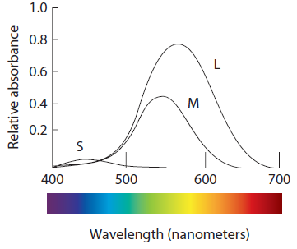
Cones
Cones come in three subtypes—short-wavelength sensitive, middle-wavelength sensitive, and long-wavelength sensitive
There are fewer blue (short-wavelength) cones than red or green. These cones are also less sensitive to light
Note the overlap in sensitivity distributions: the brain takes the difference between the L and M signals to get hue information

Slide 5
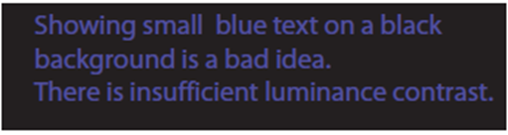
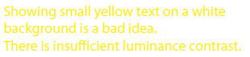
Consequences of cone types
A consequence of our having few and weak blue-sensitive cones is that it is a mistake to show text or anything else with detail using blue on a dark background. The result is usually illegible.
A pure yellow hue excites the middle- and long-wavelength cones, making yellow the lightest of all pure hues.
The red- and green-coloured cones are clumped together.
We can see considerable detail in black and white images because for parts of the image to fall on two or more different cone receptors, no matter which type.
But the patchy nature of the different cone types means that we are far less able to see detail where the differences are purely chromatic.

Slide 6
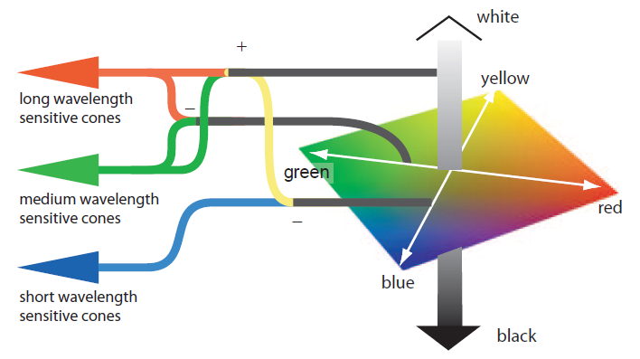
Colour-opponent channels
The red-green channel represents the difference between the signal from the middle- and long wavelength-sensitive cones. This allows us to be highly sensitive to subtle red-green contrasts
despite the overlap in the cone-sensitivity functions. The luminance channel combines the outputs of long- and middle-wavelength-sensitive cones. The yellow-blue channel represents the difference between the luminance channel and the blue cone signals.

Slide 7


Contrast
The effect of simultaneous contrast is distortion of the appearance of a patch of colour in a way that increases the difference between a colour and its surroundings. This is called lightness or brightness contrast when it occurs in the black-white channel and chromatic contrast when it occurs in the red-green or yellow-blue channel.
Chromatic contrast occurs in the red-green and yellow-blue channels. Its effects are much more complex and harder to predict than grey-scale contrast.

Slide 8

Unique hues
The opponent-process theory suggests that the colours black, white, red, green, yellow, and blue are special. Each occurs when there is a strong signal (either positive or negative) on one of the channels and a neutral signal on the other two channels.
A remarkable study of more than one hundred human languages by Brent Berlin and Paul Kay carried out in the 1960s showed these basic colour terms are the most commonly used no matter what the language.

Slide 9
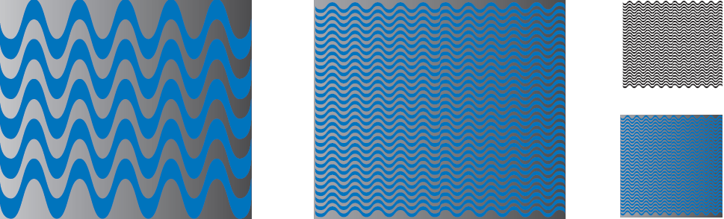
Sensitivity to spatial detail
The luminance channel has much greater capacity to convey detailed information than the chromatic channels.
The patterns show that we can still see large shapes represented chromatically, but the fine pattern is much harder to see expressed through chromatic differences than when expressed through black-white differences.
Luminance also conveys motion, stereoscopic depth and shape better than chromatic channels

Slide 10
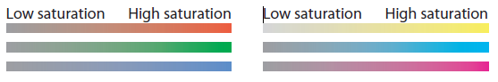
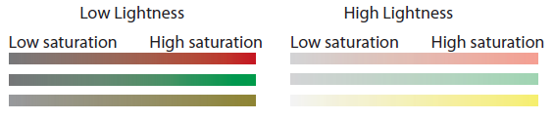
Saturation
More saturated (vivid) colours are those that have strong signals on one or both of the chromatic channels.
When colours are dark there is a smaller difference signal on the chromatic channels, and saturations are lower for dark colours
When colours are light there is also usually a reduction in saturation for reasons having to do with colour reproduction technology rather than perception

Slide 11
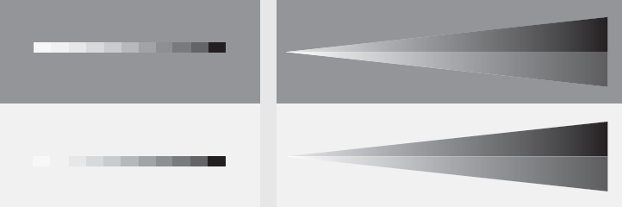
Luminance nonlinearity
The luminance channel is nonlinear.
We are more sensitive to dark grey differences than to light differences, although this effect also depends on the background.
With a dark grey background, our sensitivity is increased to grey differences in the mid-range.
With a light background, our sensitivity is increased to differences near white. Th is effect is sometimes called sharpening.
The top and bottom patterns are the same: just the background differs

Slide 12
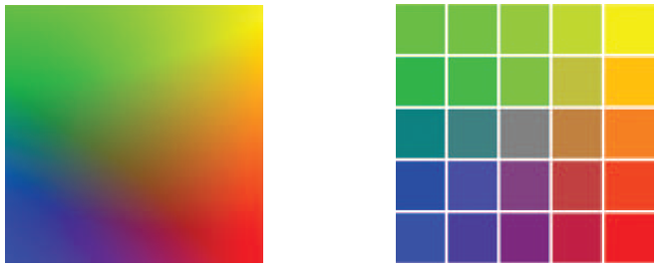
Colour segmentation
The visual system has a strong tendency to segment smoothly changing colours into regions consisting of the unique hues
This is why rainbow colourmaps don’t work well
The eye tends to divide the smoothly varying colours in the square on the left into regions of red, green, yellow and blue. To a lesser extent, purple and orange can be seen. It is
almost impossible to see the neutral grey in the centre. In the segmented version (on the right), more colours are perceived even though there are actually fewer present.

Slide 13
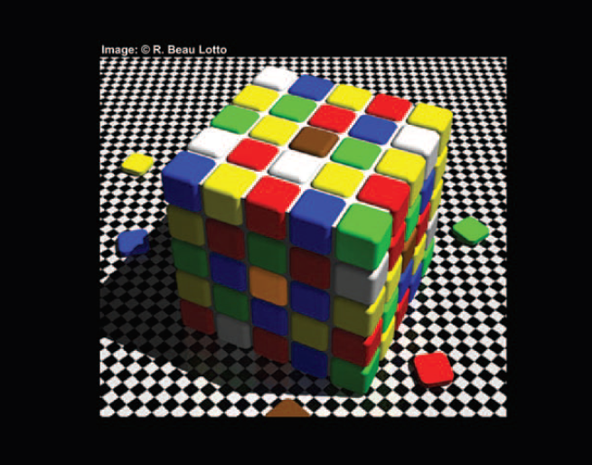
Colour appearance
Colour appearance has more than three dimensions. The reason is spatial. A patch of colour is never seen in isolation, and its appearance is affected by the colours that surround it, its orientation with respect to the light source, whether is it perceived as lying in or out of shadow, the texture of the surface on which it lies, etc.
The (apparently) brown square at the top centre has exactly the same colour as the (apparently) yellow square in the centre of the front face. If you don’t believe it, cut a small hole in a piece of white paper and
use it to examine each patch of colour with the surroundings blocked out.
(Image created by R. Beau Lotto)

Slide 14
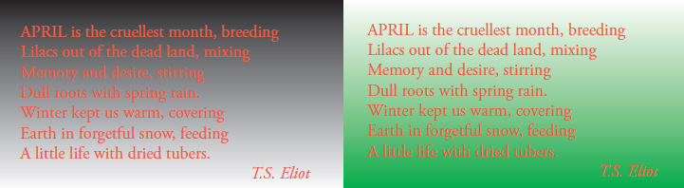
Design principles: showing detail
Whenever detailed information is to be shown, luminance contrast is necessary
As graphical features get larger, so the need for extreme luminance contrast declines
When text is small it is essential that there be luminance contrast with the background colour.
Notice how the text is hardest to read when the luminance contrast is lowest.
When text is big, anything goes.

Slide 15
Colour-coding information
In the design of colour codes, the two primary considerations must be visual distinctness, to support visual search operations, and learnability, so that particular colours come to “stand for ” particular entities.
When learnability is the issue, it is important to use the unique hues first—red, green, yellow, and blue—followed by other colours that have relatively consistent names: pink, brown, orange, grey, and purple.
Up to 12 colours can reliably be used
To effectively support visual search the colours of the background and the other symbols in the set are as important as the symbol being searched
When we conduct a visual search for an object having a particular colour our brains tune our visual systems so that neurons sensitive to that hue get to “shout louder” than neurons tuned to other colours.

Slide 16
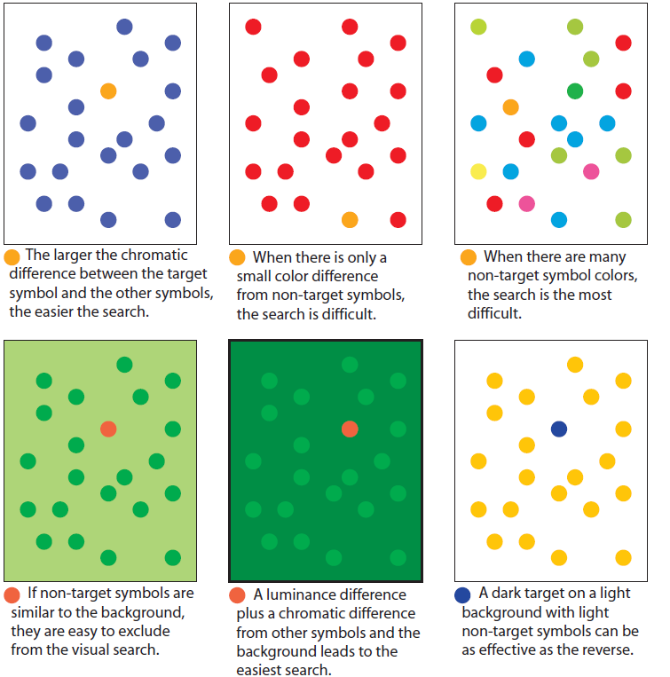
Searching on colour

Slide 17
Colour on maps
Consider reading quantitative values from a map; for example, judging the height or energy level at a particular location
Contrast effects in a grey-scale sequence can lead to very large errors reading off data values using a key
Best solution may be to provide a sequence that spirals up through colour space, starting off with a dark colour and selecting a series of colours, each of which has higher luminance than the previous one
Temperature differences (from normal) for the Pacific Ocean at 100 meters depth during an El Niño period. Warmer than usual is shown as red. Cooler than usual is shown as blue. Zero difference is shown as white.

Slide 18
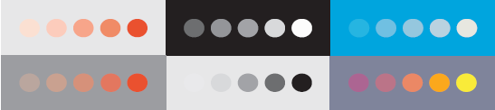
Semantic of colour
Colours are often used symbolically – but this is culturally determined.
In western culture, red represents danger, heat, and stop; green represents go, safety, and renewal; blue represents cold; white represents purity, and so on.
In China red is used to symbolize good fortune and renewal.
In most of Asia, white is the colour for mourning, whereas in the west it is black.
Other semantic mappings relating to quantity may be more universal. Quantities that are larger should generally be mapped to colours that are more distinct.
This visually means that more saturated colours should be used to represent greater quantity.
Similarly, darker colours on a light background or lighter colours on a dark background can be used to indicate greater quantity.
Six different ways of showing greater quantity. All involve increasing the relative difference from the background colour.

Slide 19
Summary
Based on colour-opponent theory, the functional aesthetics of colour can be reduced to a remarkably small number of guidelines
Every region of an image is evaluated with respect to its adjoining regions in terms of how much it differs in each of the channels
As a result, we can reliably use only a handful of very different colours symbolically to label information
Showing blue detail on a black background or yellow detail on a white background are bad ideas
Colour design is subtle and can be a source of beauty and pleasure or disgust and irritation
Psychophysics can help, but much of it is a matter of socially constructed taste

